Slide 1
RSS – Lab 4: ROS and Visual Servoing
Team VI: The Sentinels
Daniel Gonzalez Neil Forrester
James Wiken Raga Srinivasan

Slide 2
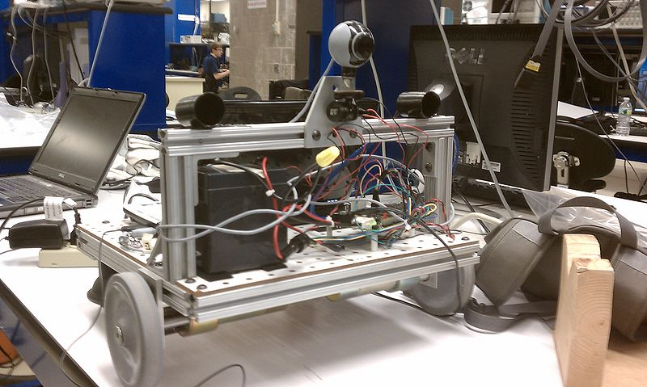
SENTINEL as of Lab 4

Slide 3
ROS
Set up to work with the Workstation
Running different processes on both the netbook and the workstation
Allows improved transfer of streams of data
Stream of video from webcam in our case

Slide 4
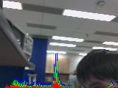
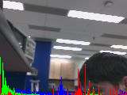
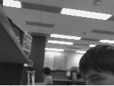
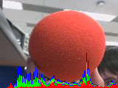
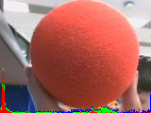

Target Pixel Characterization
RGB Histogram
HSB Histogram
blobPixel output
Without Ball
With Ball

Slide 5
Visual Servoing
Running from Workstation:
Response time of 1-2 seconds
No false negatives, unless ball obscured
False positives if there are small red objects, but no ball present
Running fully Autonomously:
Response time reduced to .5-1.0 seconds
False negatives and positives unchanged

Slide 6
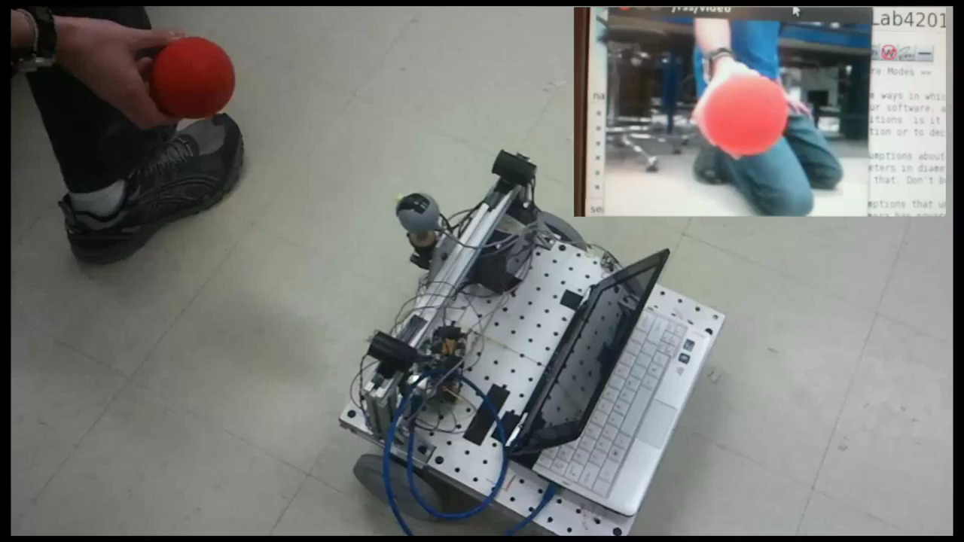
Visual Servoing
NEED VIDEO

Slide 7
What we learned
Basic structure and use of ROS
Implementation of digital image processing techniques
Blob detection
Blob size
Centroid estimation
Implementation of “visual servoing”
Realized assumptions and limitations of robot

